Slide 1
Rooted In Community
ALIVE! in Alexandria
alive-inc.org
jayers@alive-inc.org

Slide 2
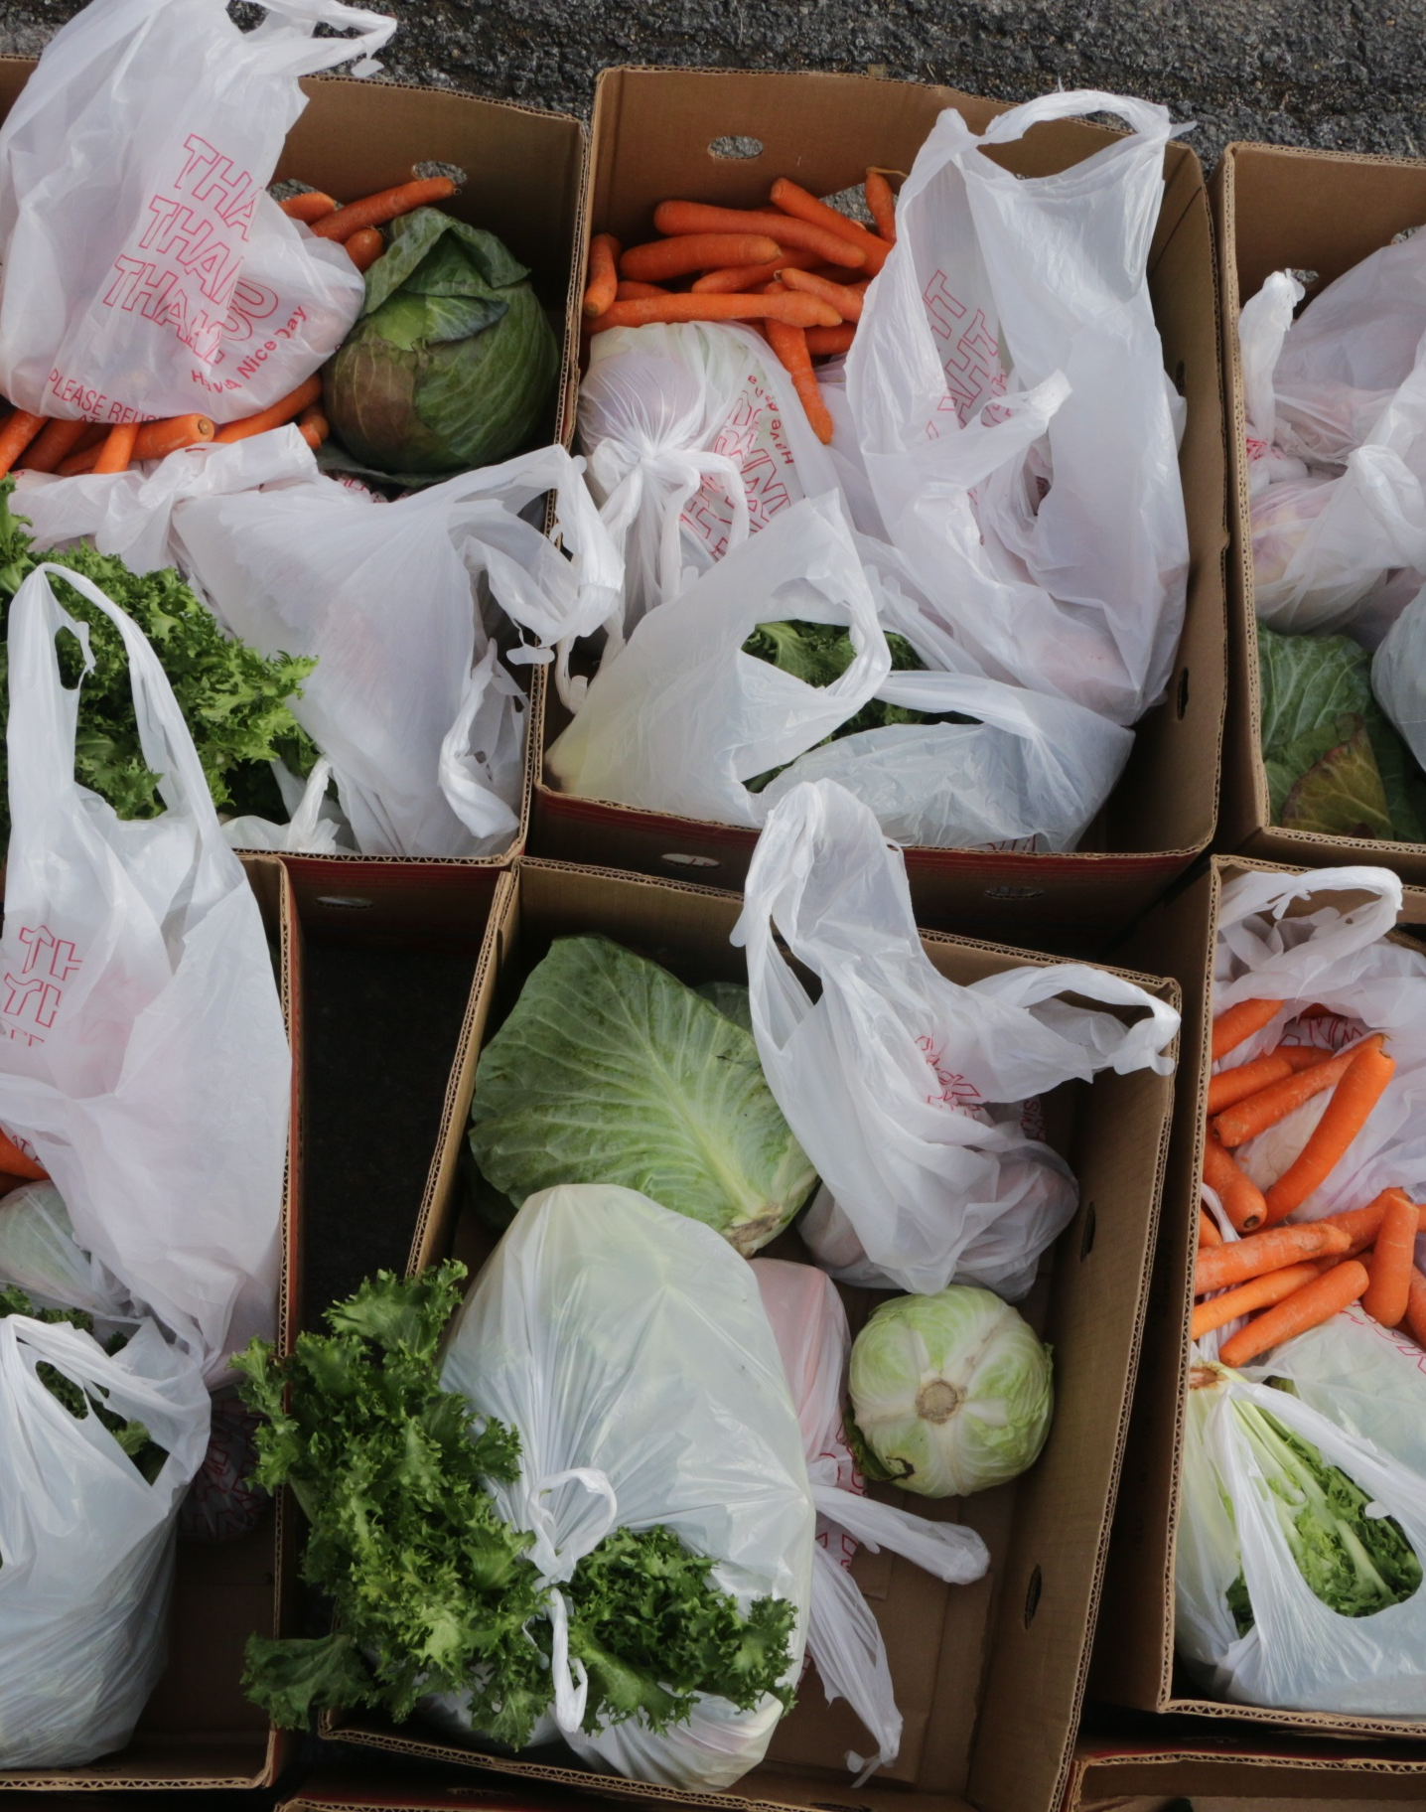
Vision & Mission
To alleviate the suffering caused by poverty and to dramatically improve the lives of those in need in the city of Alexandria.
Through faith and love, to help people faced with emergency situations or long-term needs become capable of assuming self-reliant roles in the community.

Slide 3
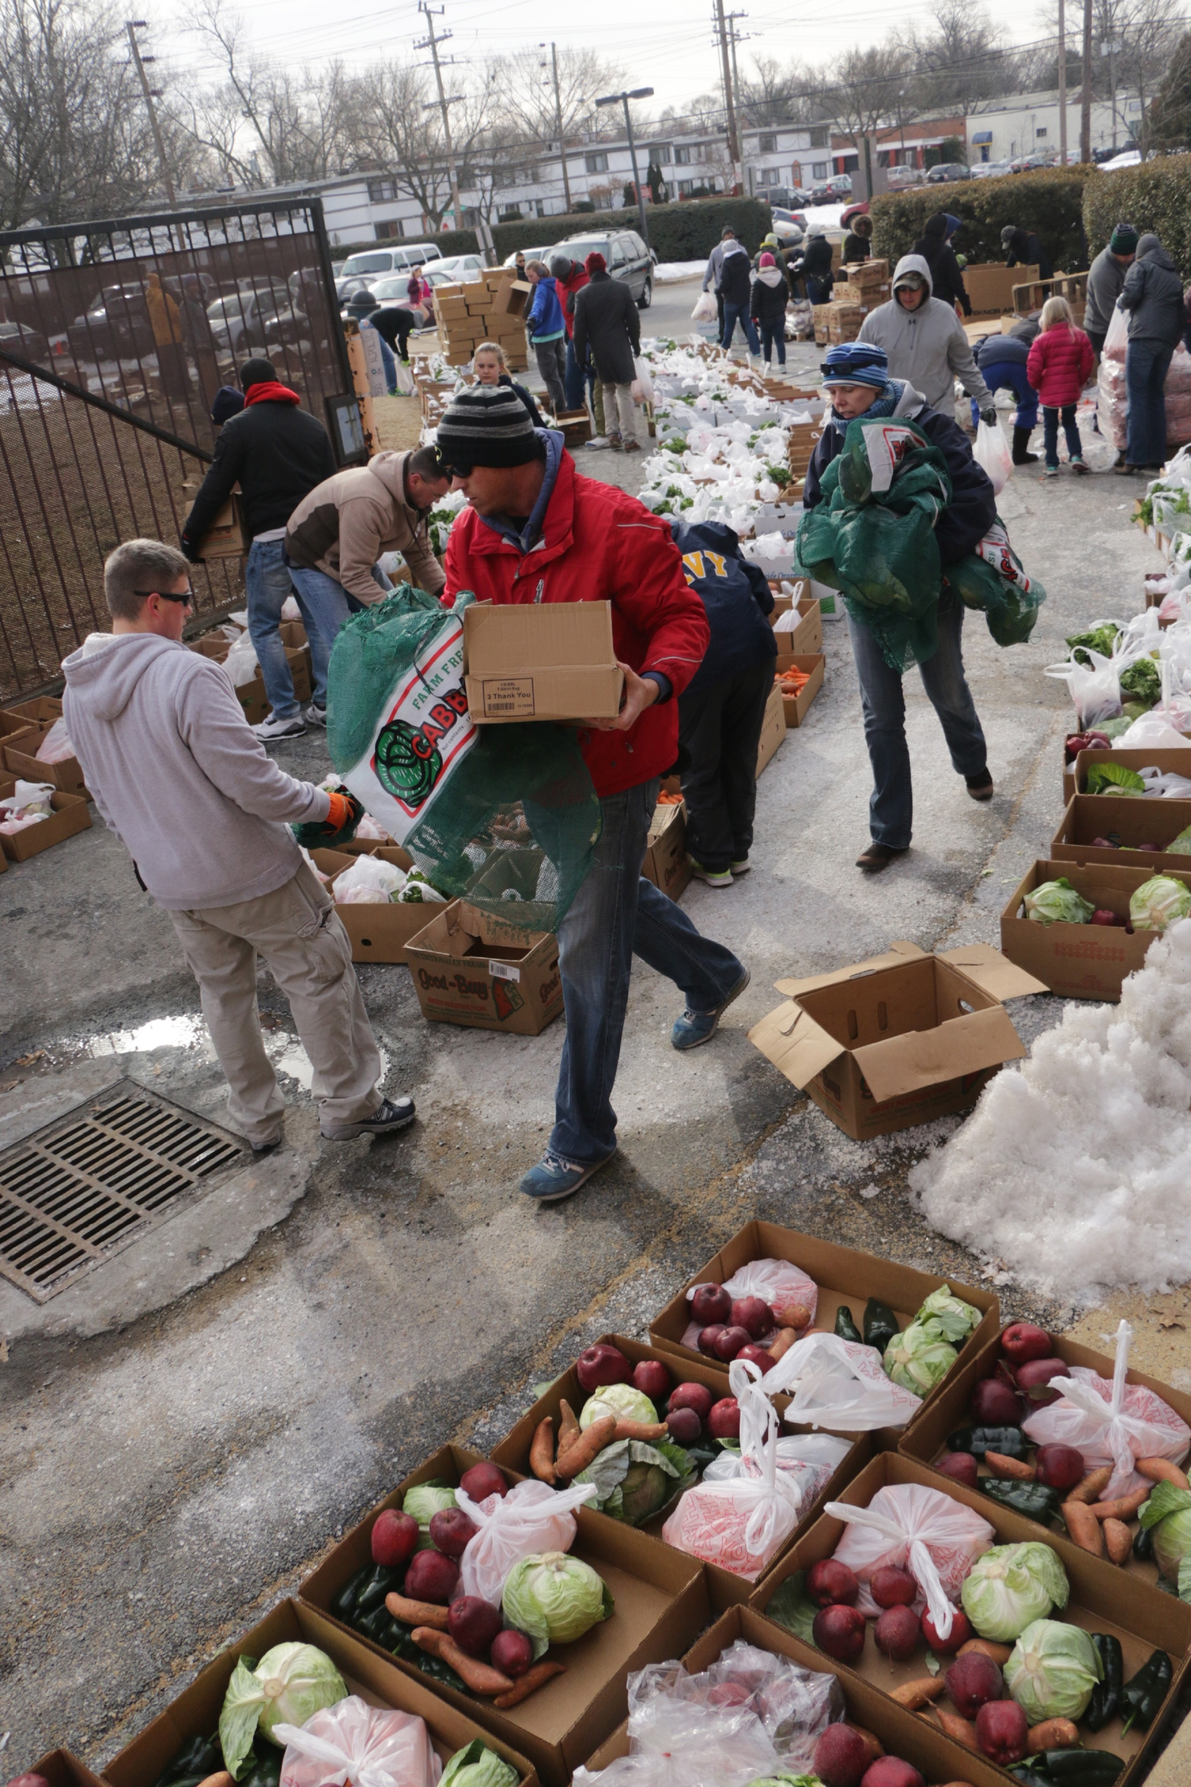
History & MLK
Following MLK’s Poor People Campaign March on Poverty in 1968
Alexandria Involved Ecumenically (ALIVE!) was founded 1969 by 14 Faith Communities who were concerned about rising levels of poverty in city of Alexandria
Started by people who thought they could help meet basic needs

Slide 4
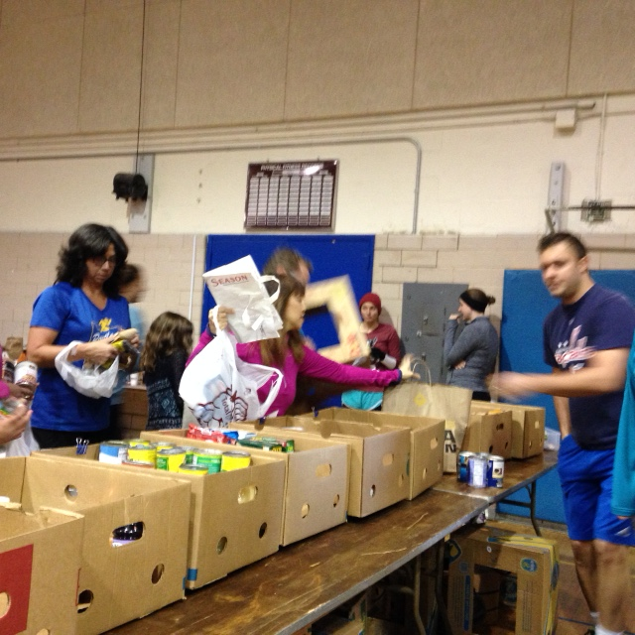
Who we are today
50 interfaith Member Congregations
Many Community Partners, City Agencies, nonprofits, Businesses, and others who help ALIVE!
Supported by grants, individual donations, donations from our congregations, community organizations, and businesses.
Major Events
Empty Bowls
Step ALIVE! Walk-a-Thon
Sidewalk sale
Spring2ACTion

Slide 5
ALIVE! Activities
Food Distribution
Furniture
Financial Assistance
Housewares
Transitional Shelter ALIVE! House
Service Navigation

Slide 6
Detail on Programs
Food
Supply groceries to ACPS schools weekend bag & afterschool programs
Pantries and meal providers in the city and NPOs requesting food
Weekend Food Distribution Monthly- 3 sites concurrently and Pop-Up Neighborhood Food Distribution at least weekly.
Deliver groceries to people who are home bound via Financial Assistance Program
Manage city emergency food for people in quarantine

Slide 7
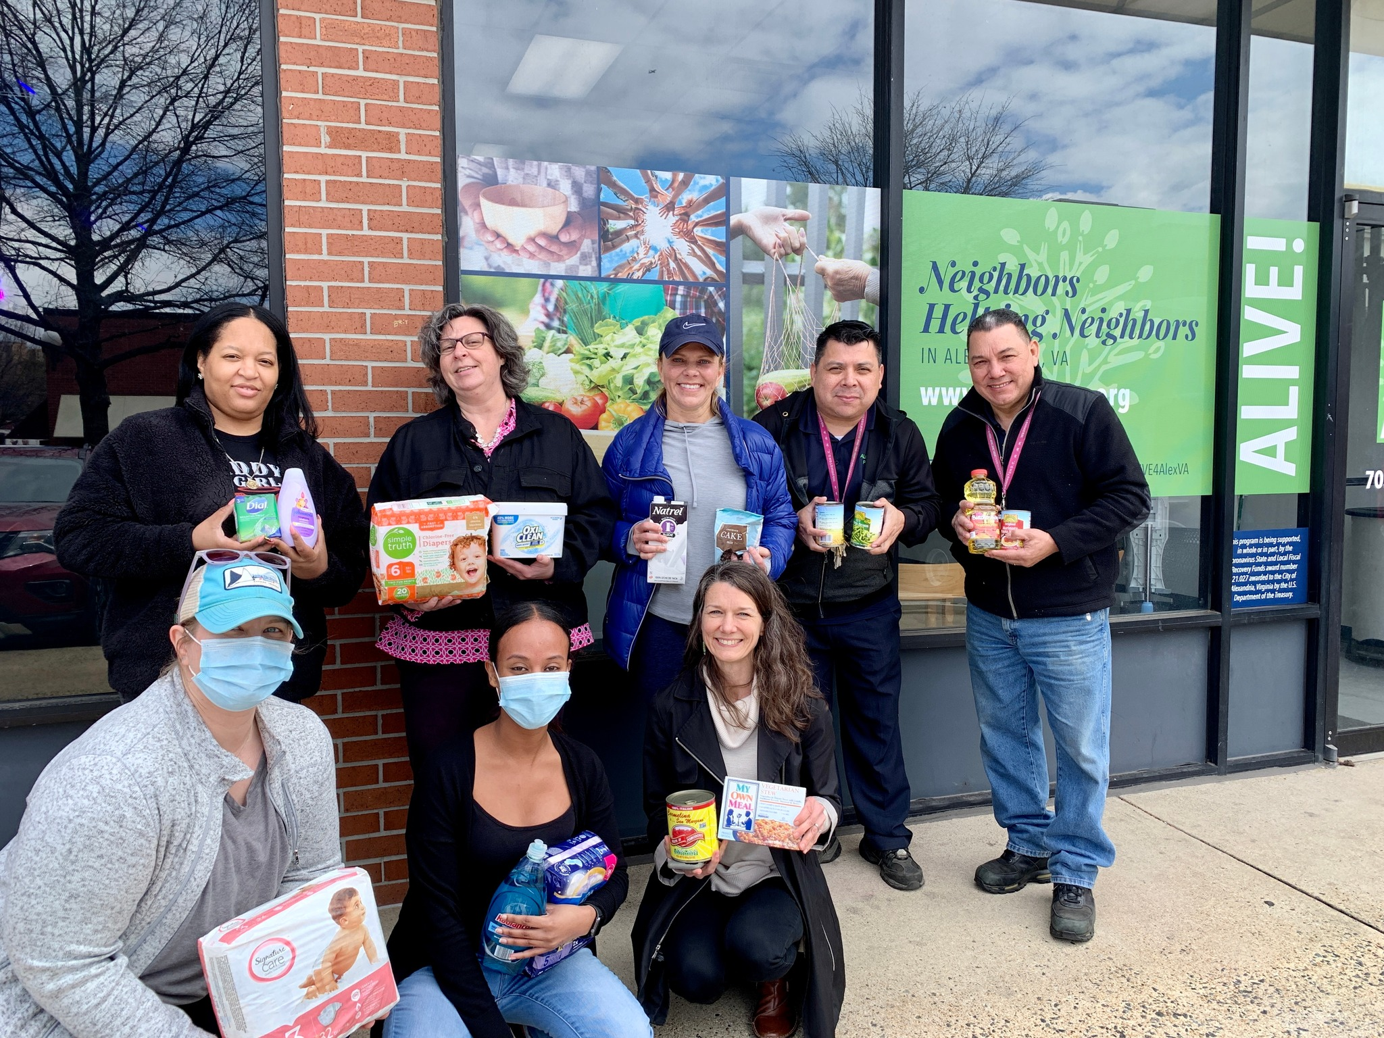
Food Hub
The ALIVE! Food Hub offers Alexandria residents: • food • personal items • cleaning supplies • school supplies • community • connections to information other services
Food Hub Hours of Operation: Tuesdays Noon-6:30pm Wednesdays Noon-6:30pm Thursdays Noon-6:30pm Fridays 10am-1pm Saturdays 10am-1pm
Located at:
510-F South Van Dorn Street

Slide 8
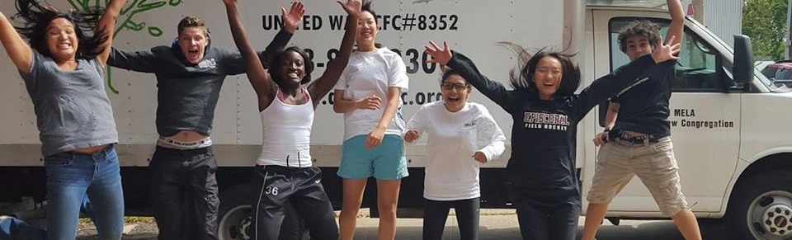
Furniture delivers and picks up 52 weekends a year. Beds, dressers, mattresses, couches, dining tables & chairs
Housewares donations of utensils, small appliances, plates, bowls, basic kitchen tools, sheets, towels, bed linens
Financial assistance utilities, rent, medical expenses. Requires a referral and up to $1,00 every few months based on what we have available- Currently increased our support and are paying out about $30,000 per month. Home delivery of groceries up to 2x per month.
ALIVE! House Transitional housing shelter for up to 4 families for up to 24 months- COVID we have 2 families in residence
Service Navigation help with eviction prevention through the AEPP or connection to other supportive service

Slide 9
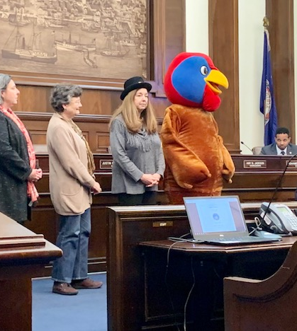
Involvement
Volunteers at every level
Program level- hand out food, load and unload furniture, deliver food & housewares
Office work- data entry, graphic design, photography, web updates, social media, events, answering phones, research and write
Translation- through all our programs
ALIVE! House- help to clean, maintenance, fundraising, mentoring, reading to kids
Meet people at warehouse to collect food
Go on food pick ups/load and unload food from truck
Host programs/run special events/attend special drives & events
Train other volunteers

Slide 10
ALIVE! Volunteer Opportunities
Food Distribution
Warehouse, truck driver, sorting, packing, delivering & distribution of food
Furniture
Drivers, schedulers and people to carry furniture
Financial Assistance
Desk workers, people to answer phones, enter data
Housewares
Pick up donations, sort and deliver, answer email, phone
Transitional Shelter ALIVE! House
Variety of tasks- seasonal repairs & Maintenance, painting
Service Navigation
Translators, people who can share knowledge & build relationships
Event Planning
Organizing, working events, fundraising
Other
Office Help, Organizing, special projects, translation, writing, data entry

Slide 11
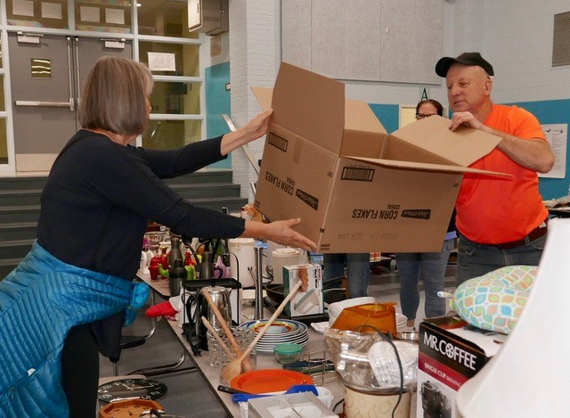
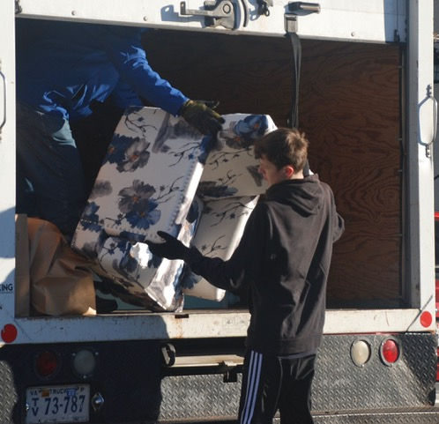
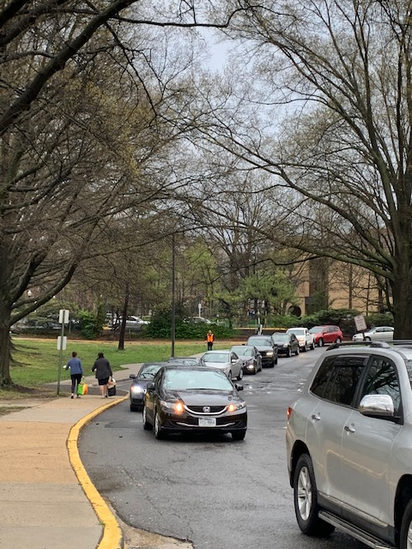
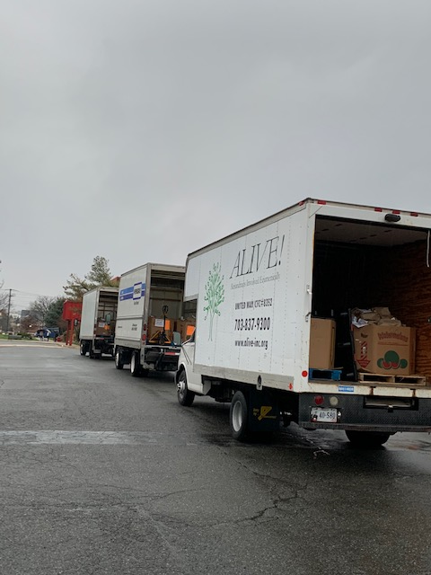
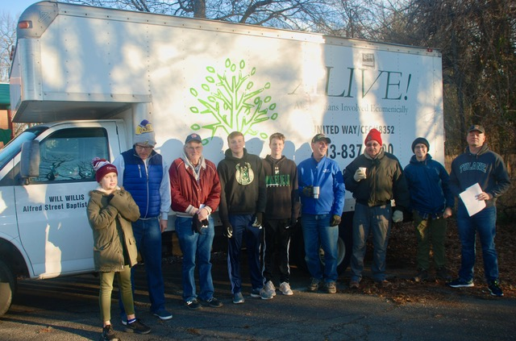
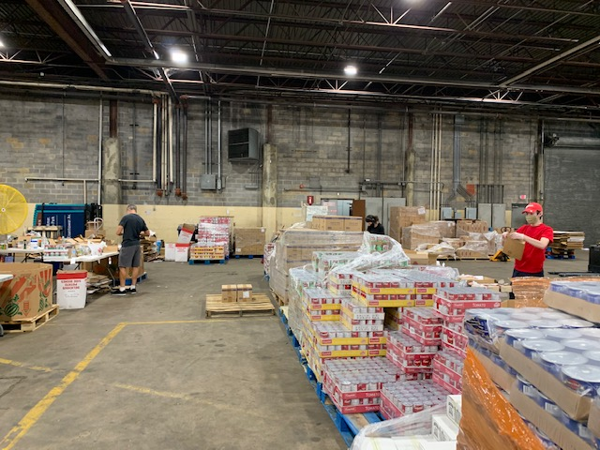
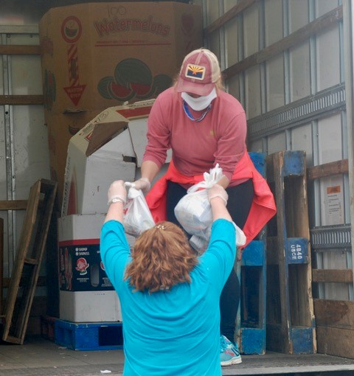
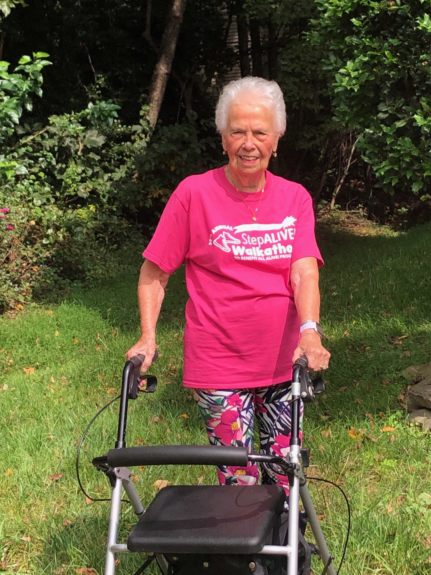
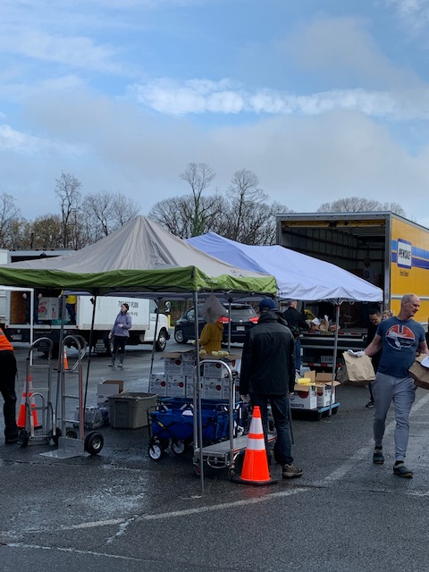
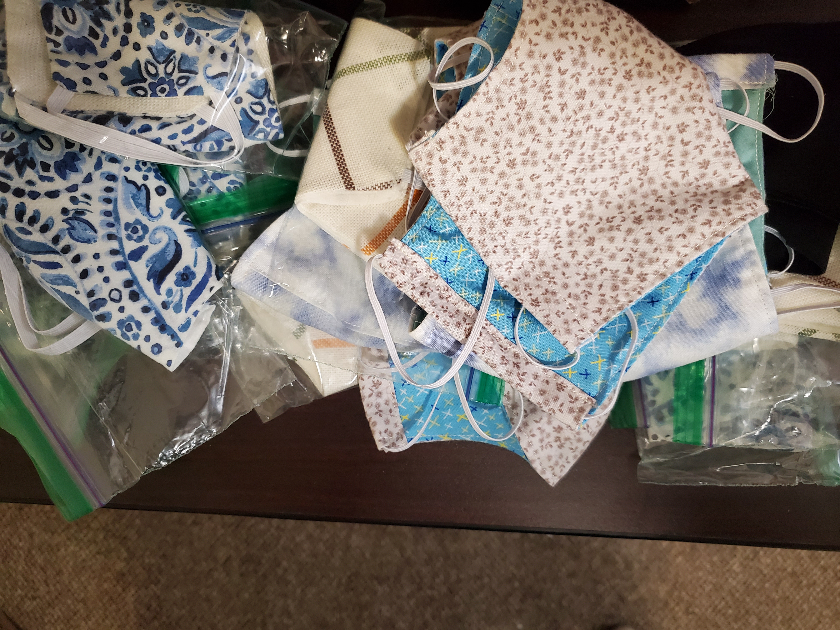

Slide 12
Contact Xiomara Hernandez:
volunteermg@alive-inc.org
Call or text: 703-548-9255
Thank you!

Slide 13
How to Connect
info@alive-inc.org
703-837-9300
www.alive-inc.org

